Slide 1
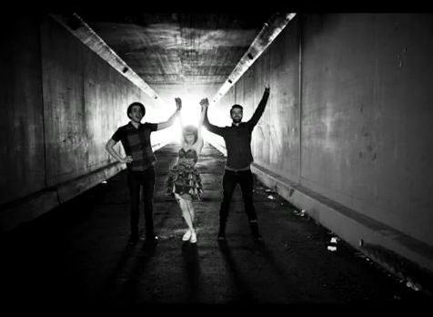
Hello Cold World by Paramore

Slide 2
I feel happy, I feel sad I feel like running through the walls

Slide 3
I'm overjoyed, I'm undecided I don't know who I am

Slide 4
Well, maybe I'm not perfect, at least I'm workin' on it

Slide 5
22 is like the worst idea that I have ever had

Slide 6
It's too much pain, it's too much freedom

Slide 7
What should I do with this? It's not the way you plan it

Slide 8
It's how you make it happen Yeah, it's how you make it happen

Slide 9
It's such a cold cold world.. (hello cold world)

Slide 10
And I can't get out. So I'll just make the best of everything I'll never have

Slide 11
It's such a cold cold world (hello cold world) And it's got me down

Slide 12
But I'll get right back up as long as it spins around Hello cold world

